Slide 1
CIS117 Week 13
Alias, history and prompts

Slide 2
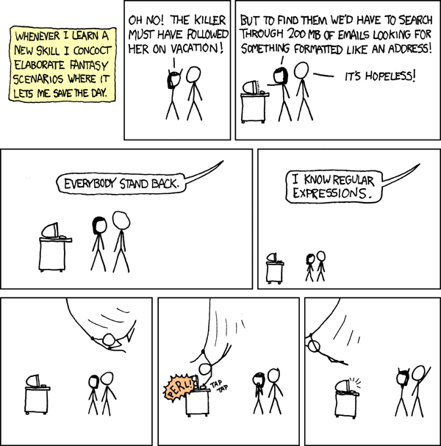
Alias
Shortcut or synonym for frequently used commands
Easy way to use complex command structures (lots of switches, pipes etc.)
To create an alias 'alias' to delete 'unalias'
To make permanent add alias to .bashrc
  DANGER HERE easy to mess up the .bashrc file use caution
https://xkcd.com/208/

Slide 3
Hidden bash files
Use the switch –a to see them, ls –a shows hidden files
.bash_profile
  Runs on log in
  Used to set paths
  Changes you want to happen at log in
.bash-history
  Records all commands used

Slide 4
Prompts
User prompt is environmental variable
  Show: echo $PS1
  Change: PS1=newprompt
Permanent change by changing .bash_profile
  DANGER!! Can mess yourself up very easily and very badly

Slide 5
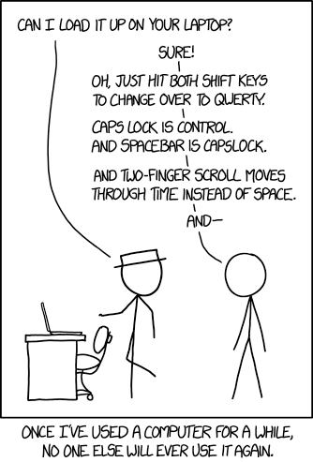
Potentially useful prompts
Show last command run
Change color if last command run was successful
Show working directory
Show directory info
https://www.explainxkcd.com/wiki/index.php/1806:_Borrow_Your_Laptop

